Slide 1
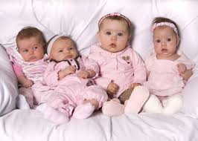
ALL BABIES ARE BORN CUTE!

Slide 2
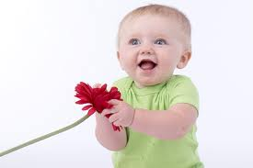
ALL HAVE THE RIGHT TO AGE APPROPRIATE DEVELOPMENT

Slide 3
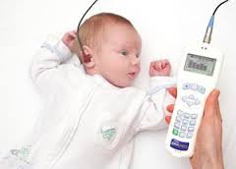
For this, each baby needs to be screened for hearing loss!

Slide 4
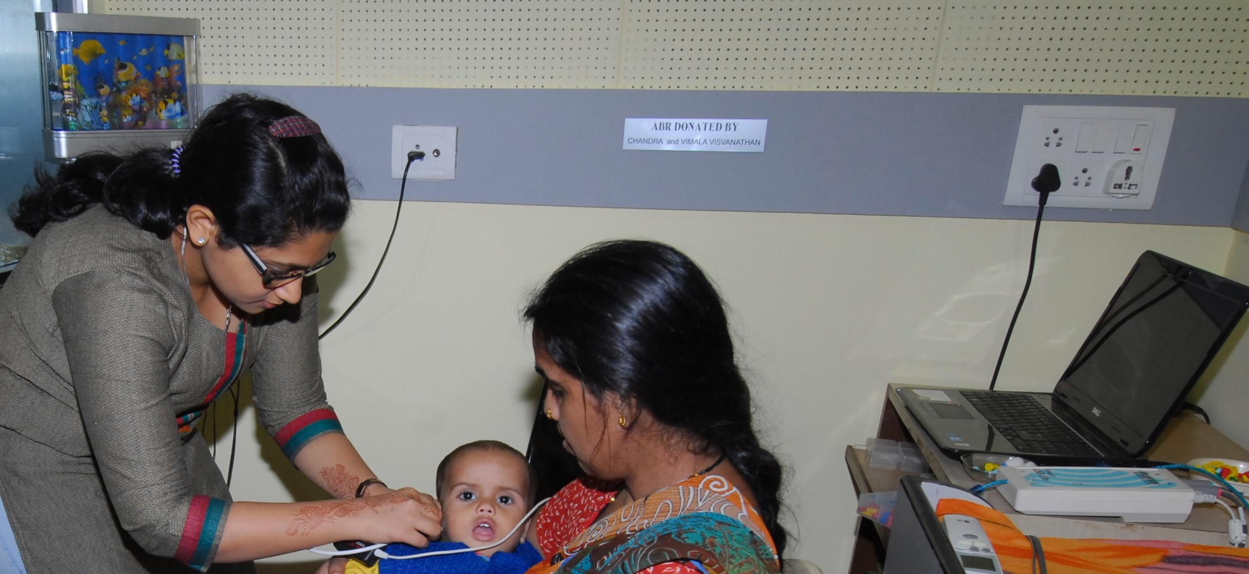
Hearing screening is painless and harmless. CAAI does it for minimum charges

Slide 5
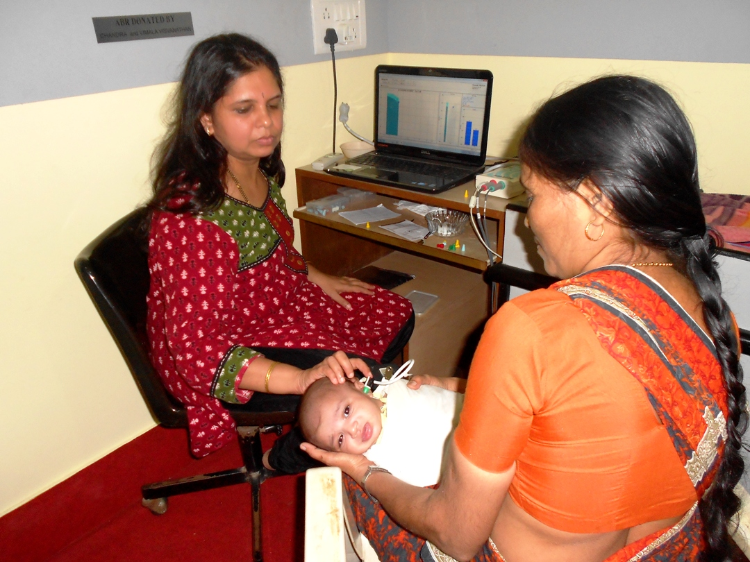
HASHU ADVANI CENTER FOR AUDIOLOGICAL ASSESSMENT AND INTERVENTION CAAI

Slide 6
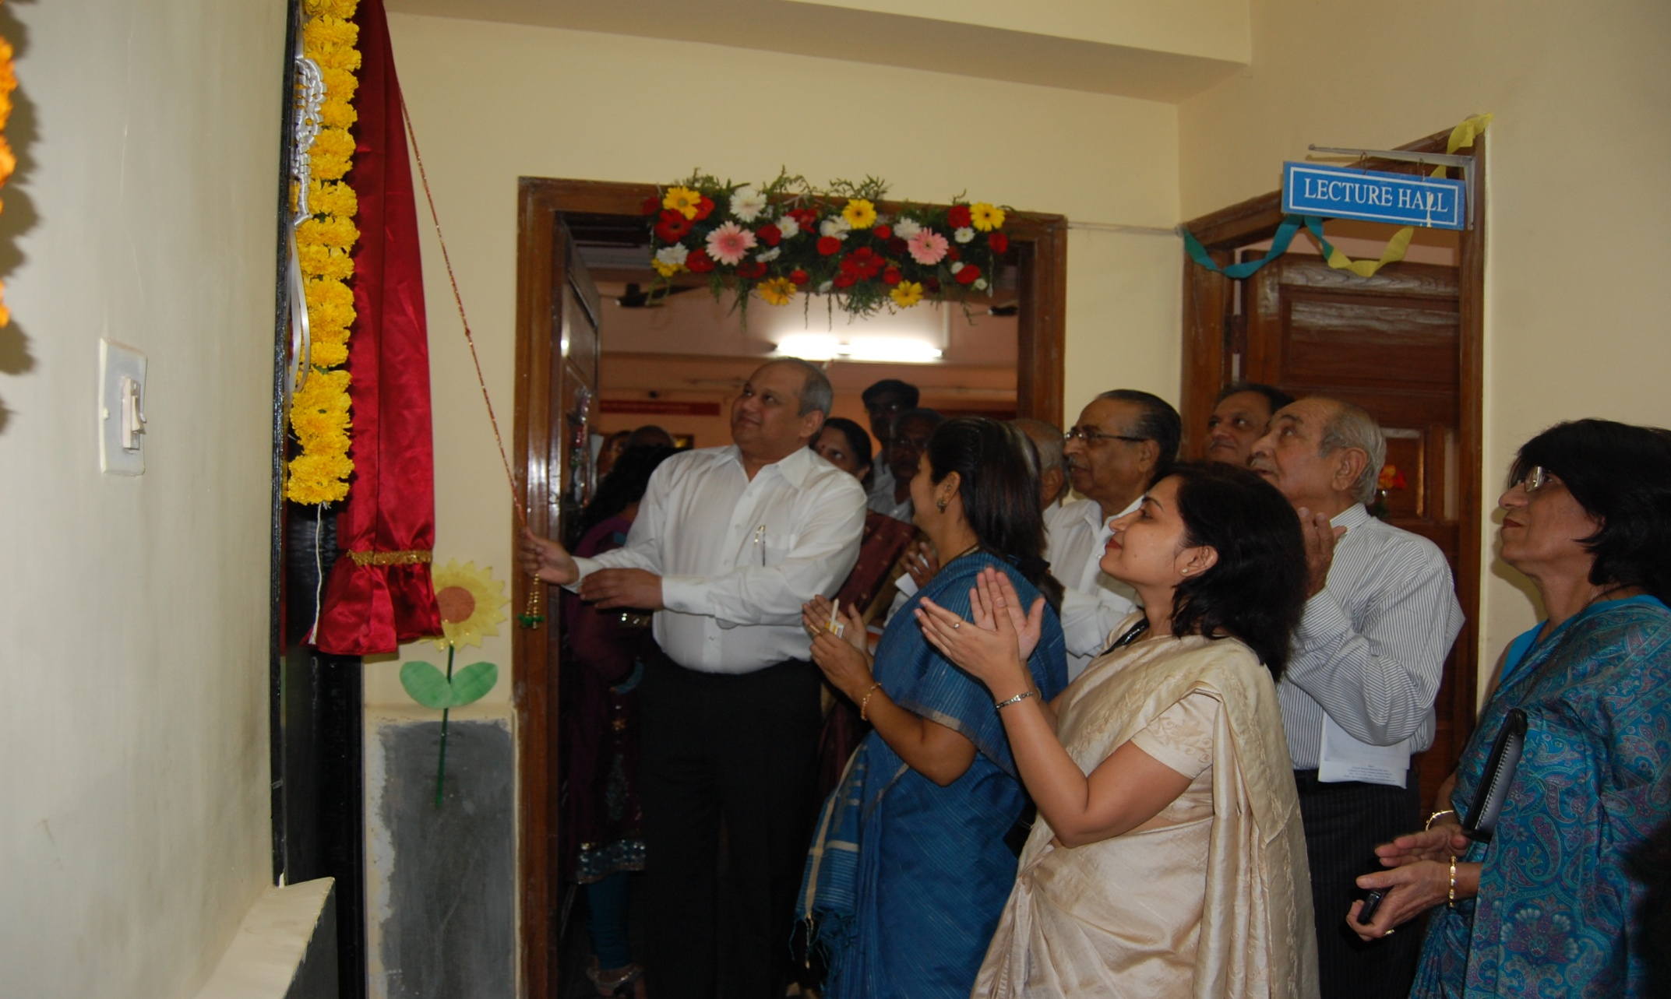
INAUGURATED IN 2011

Slide 7
CAAI – A rare service…. delivered! CAAI HAS:
Touched the lives of 1000 families so far.
Developed professional collaborations with 4 organizations.
Screened 50 orphan kids ready for adoption.

Slide 8
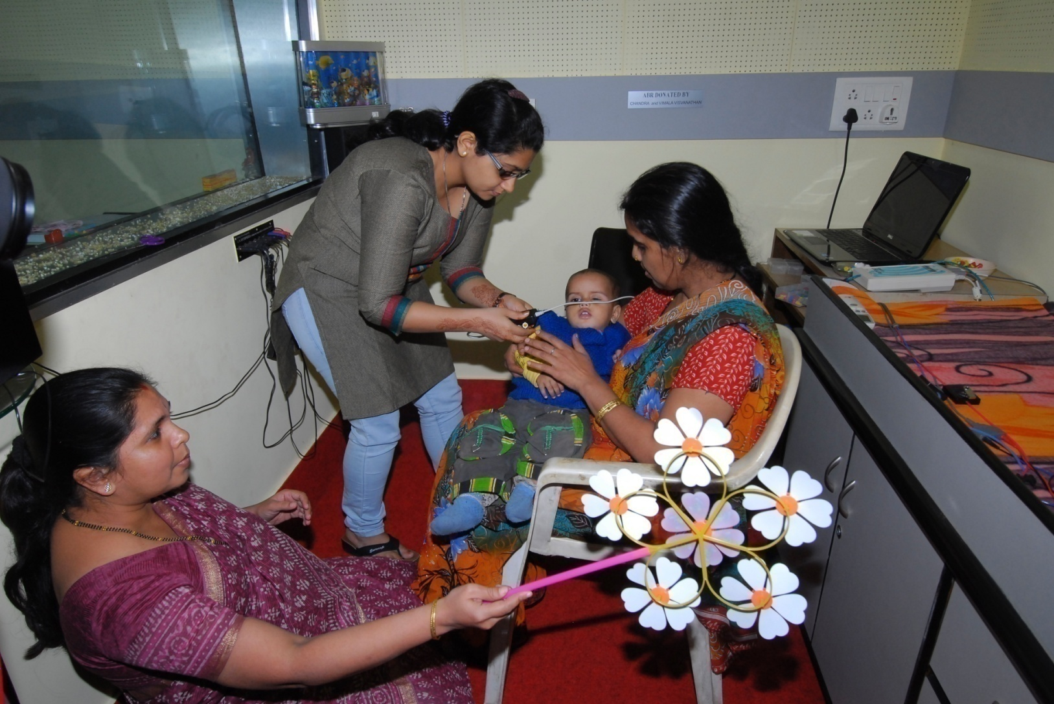
CAAI: specialized in neo natal hearing screening

Slide 9

Points to ponder!
A baby can be screened for hearing during the first week it is born.
Hearing loss can occur to ANYONE, ANYTIME, ANYWHERE.
If identified early language and speech can develop normally. …. So is academic growth!

Slide 10
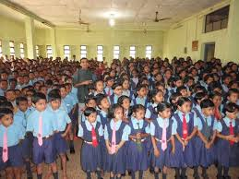
Education For All is possible only if babies with hearing loss are identified early

Slide 11

Early identification of each of the babies……
A long journey indeed!
But your support will make it happen!!!!!
BE with us……..be with CAAI.

