Slide 1
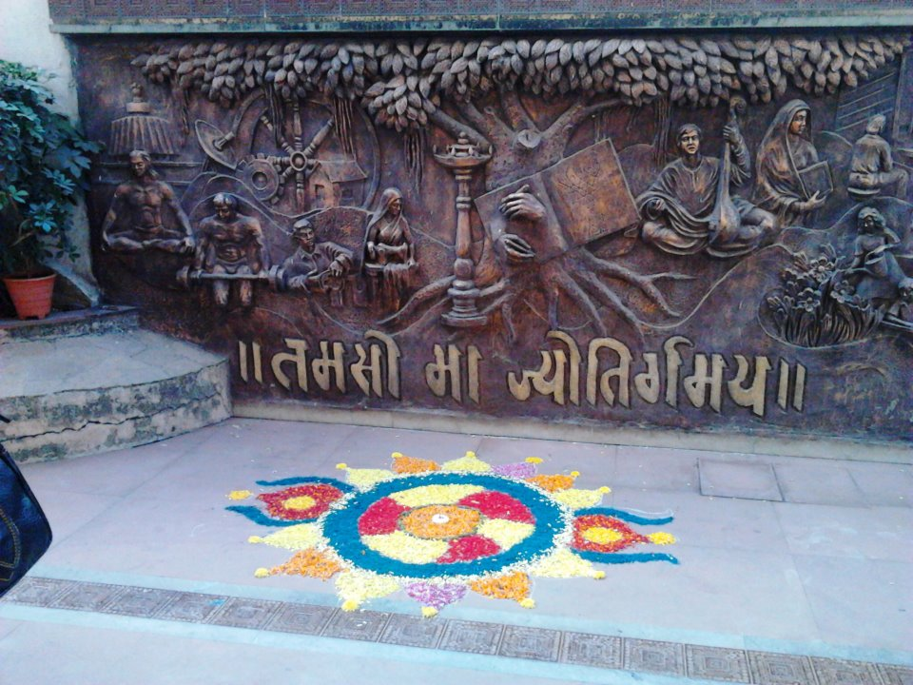
CHEMBUR COLONY YUVAK MANDAL’S
HASHU ADVANI COLLEGE OF SPECIAL EDUCATION

Slide 2
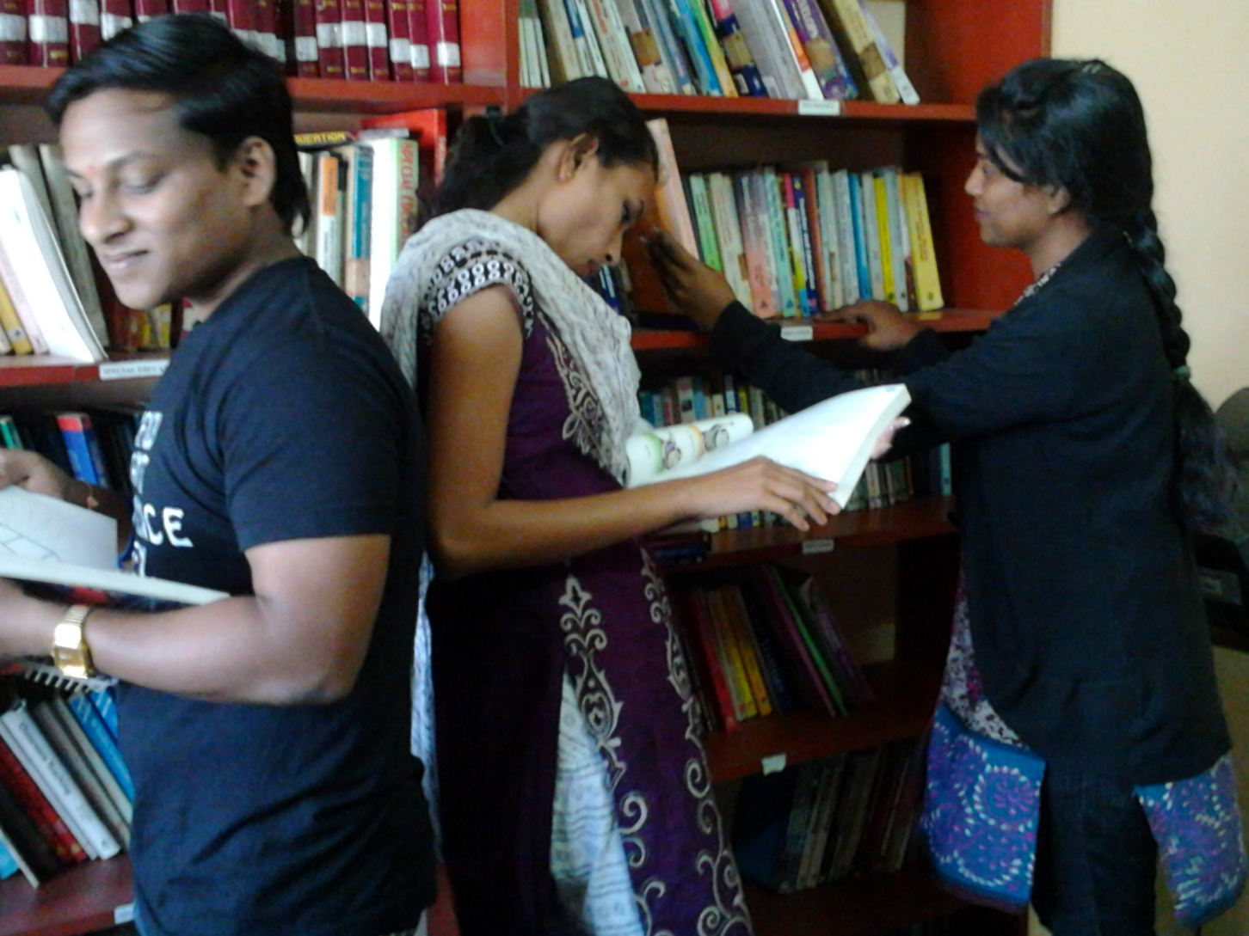
HACSE: We make learning happen….

Slide 3
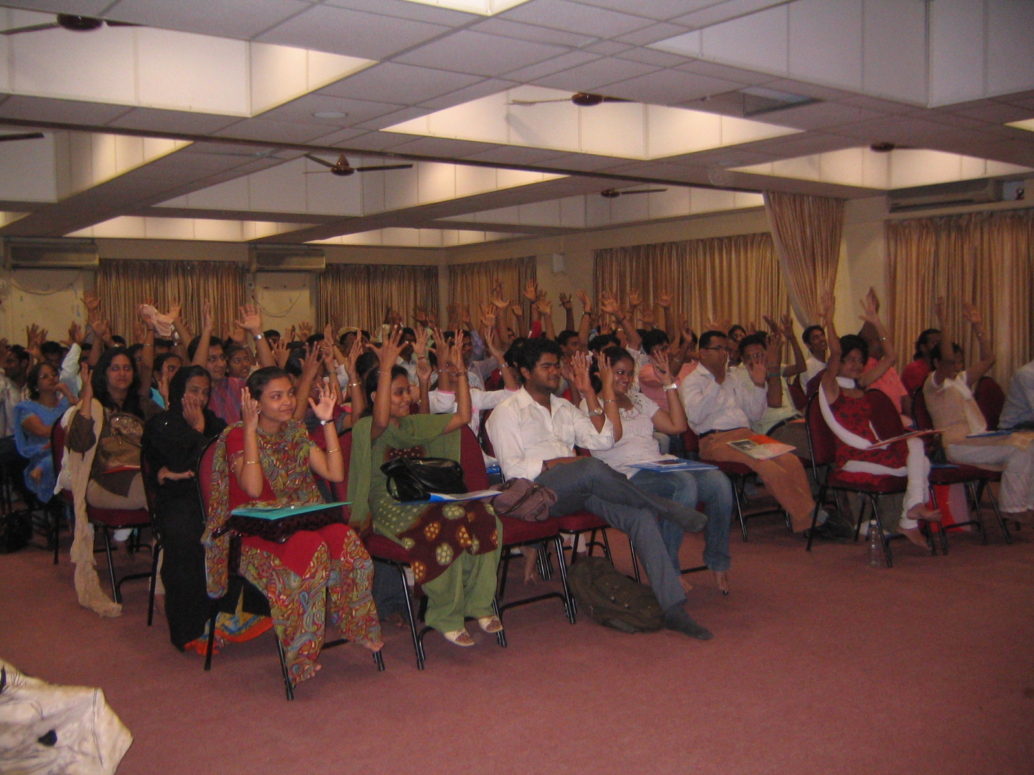
HACSE: We make skills happen….

Slide 4
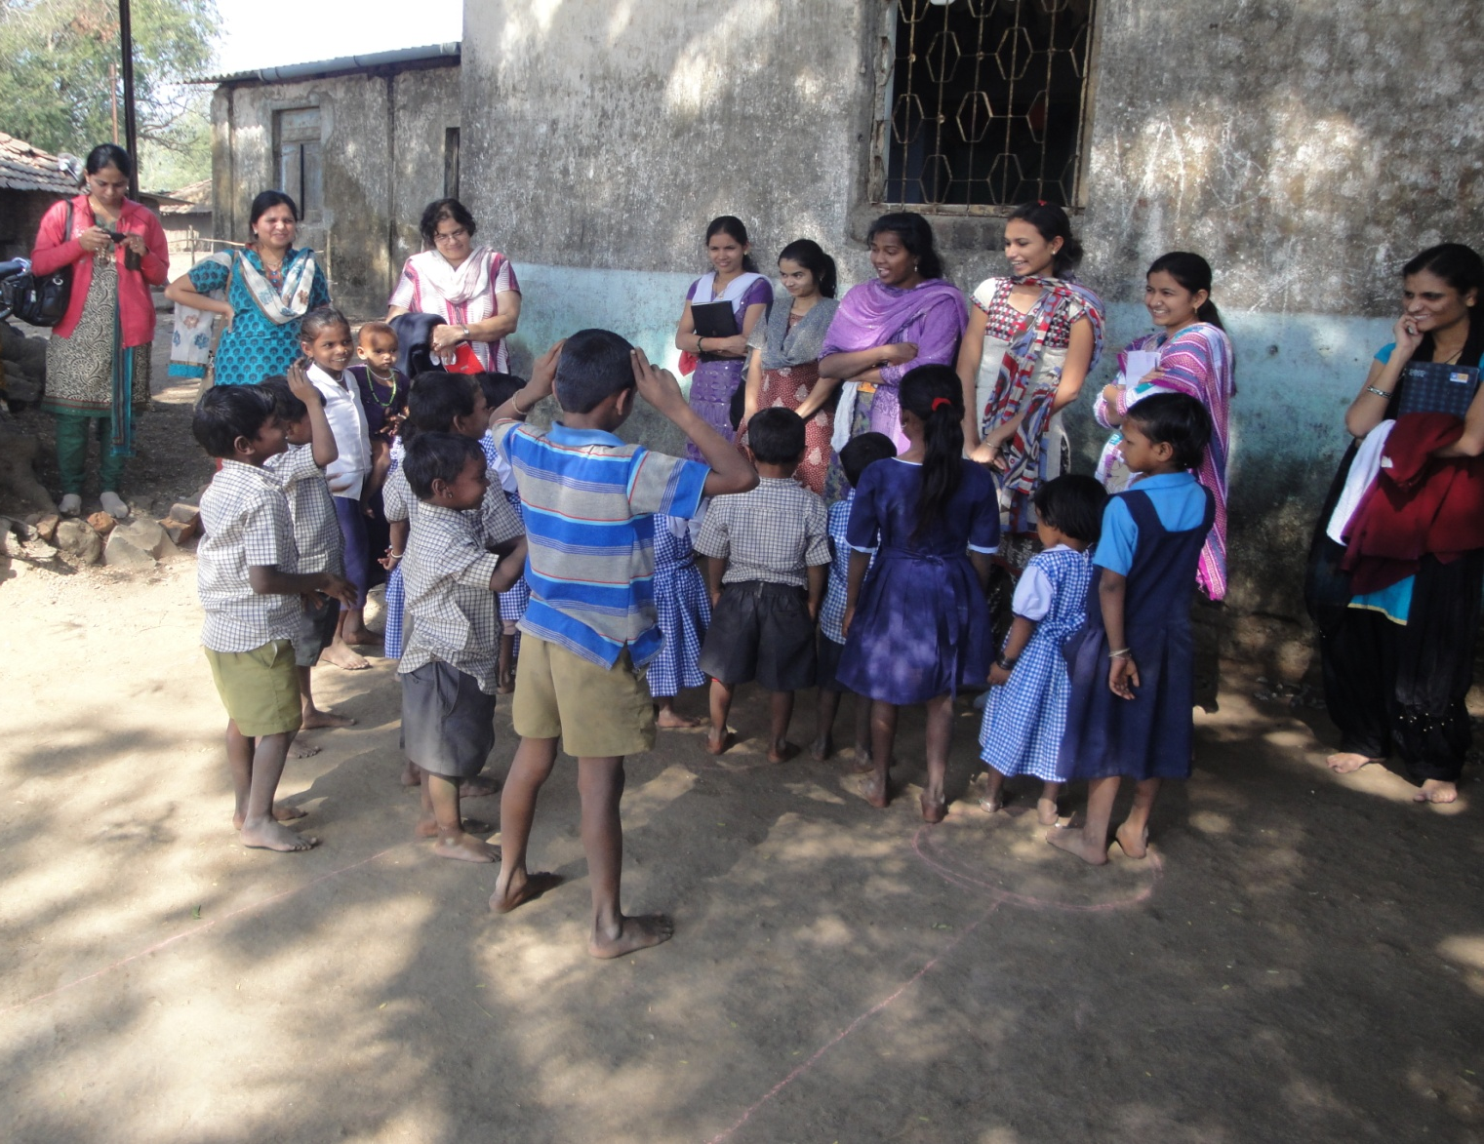
HACSE: we make fun happen…

Slide 5
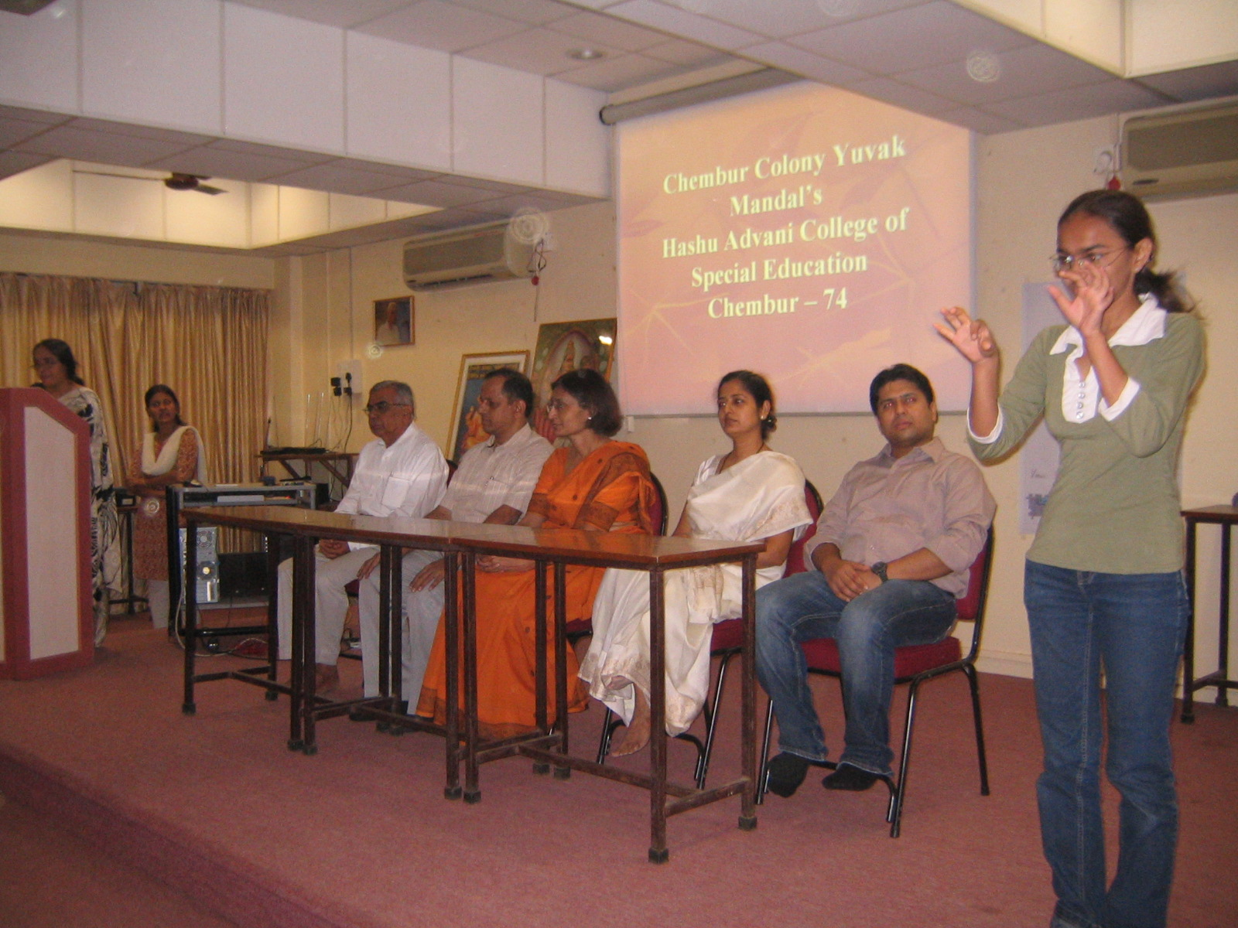
HACSE: We make leaders happen….

Slide 6
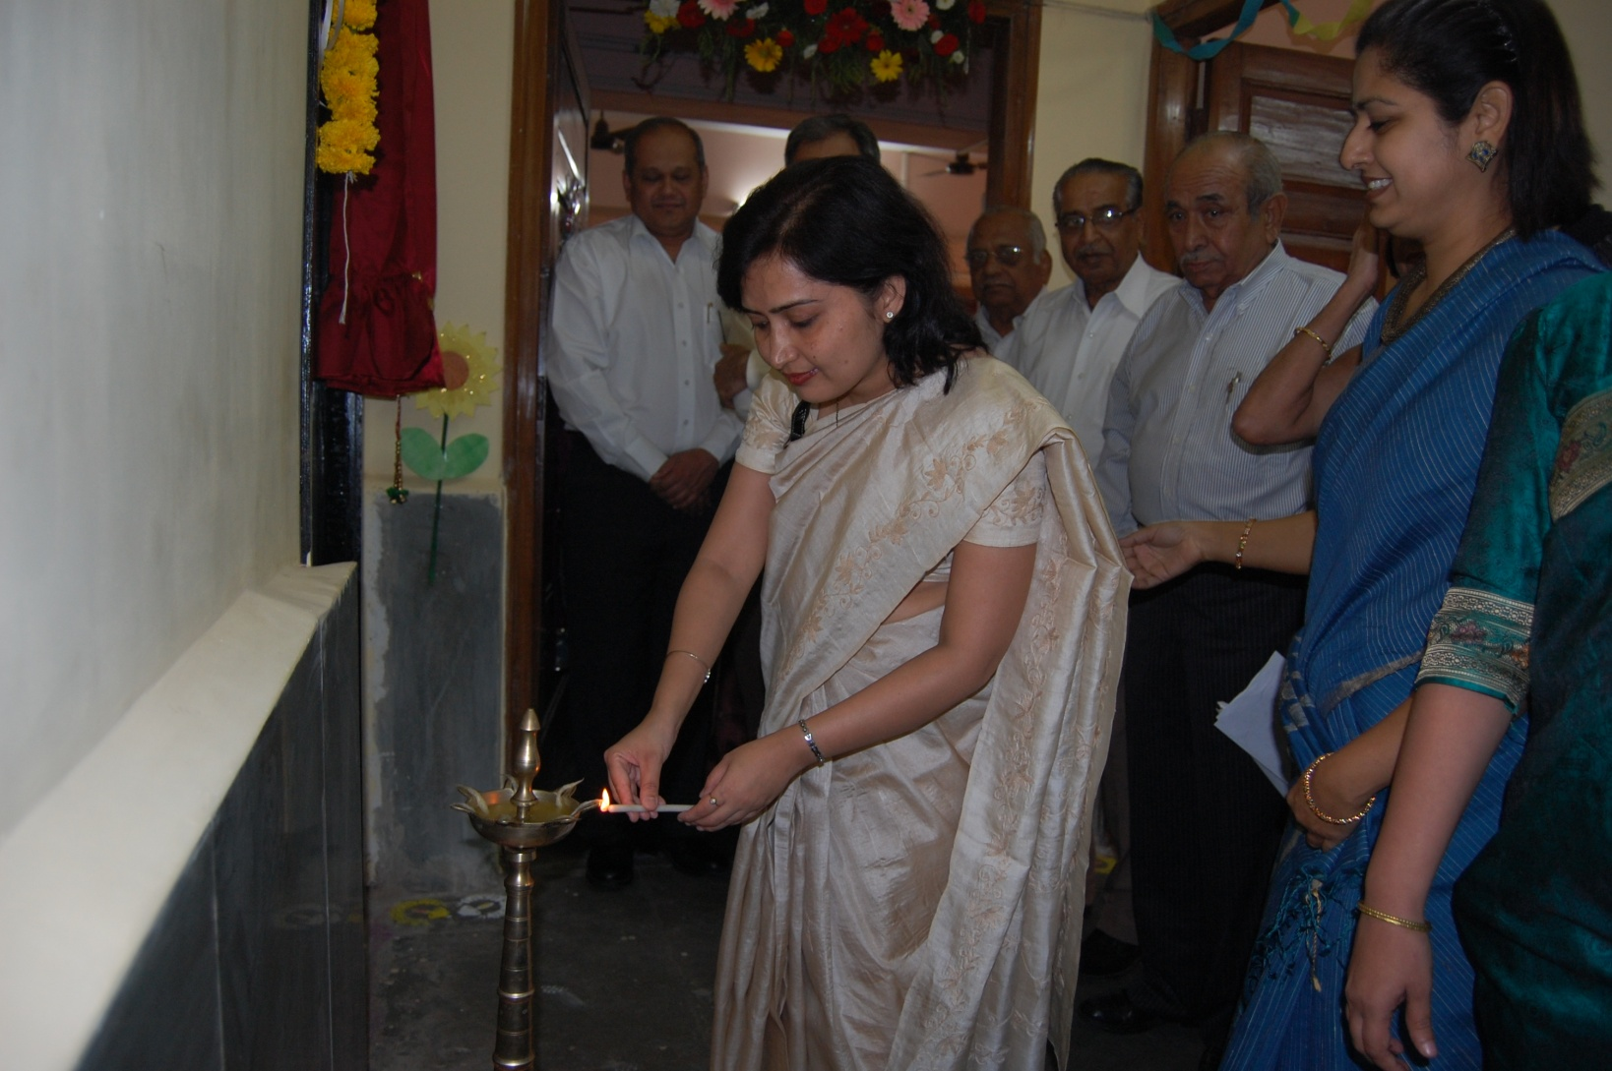
HACSE: We make services happen…

Slide 7
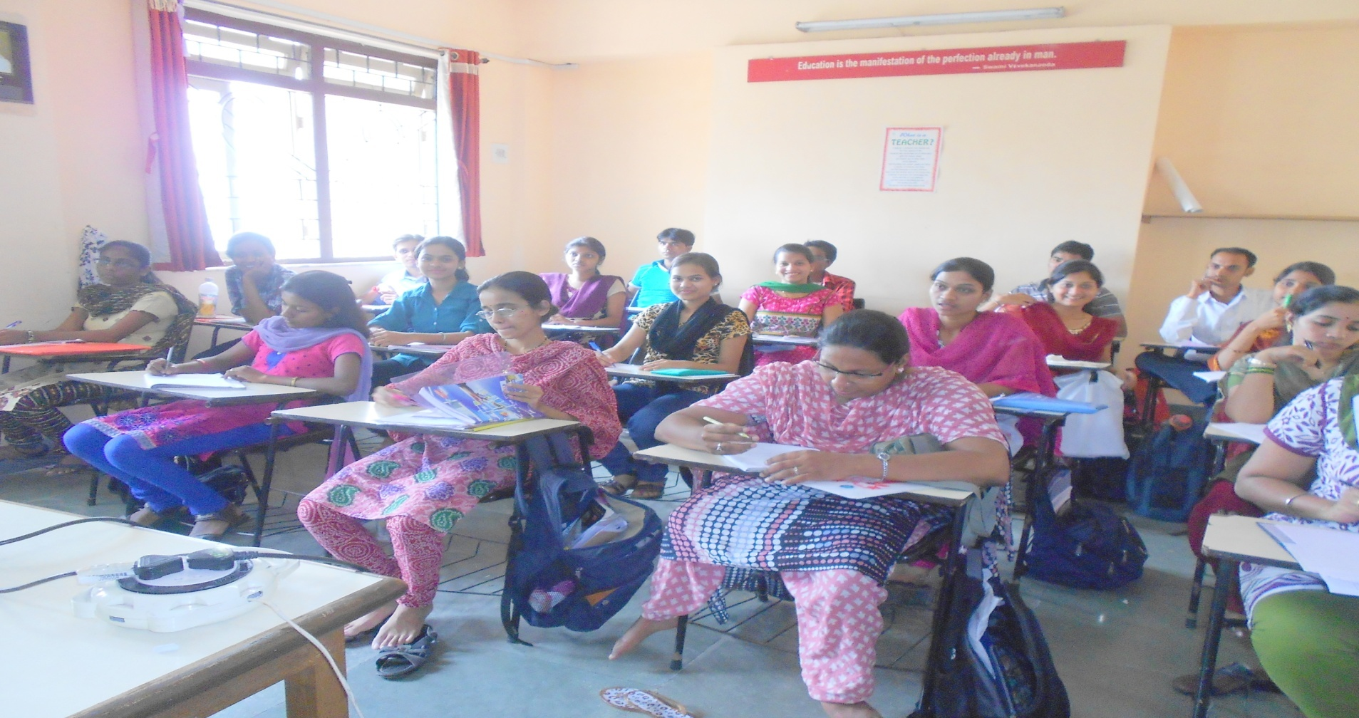
HACSE: www.hacse.org.in
Yes, we also make EDUCATION happen!

