Slide 1
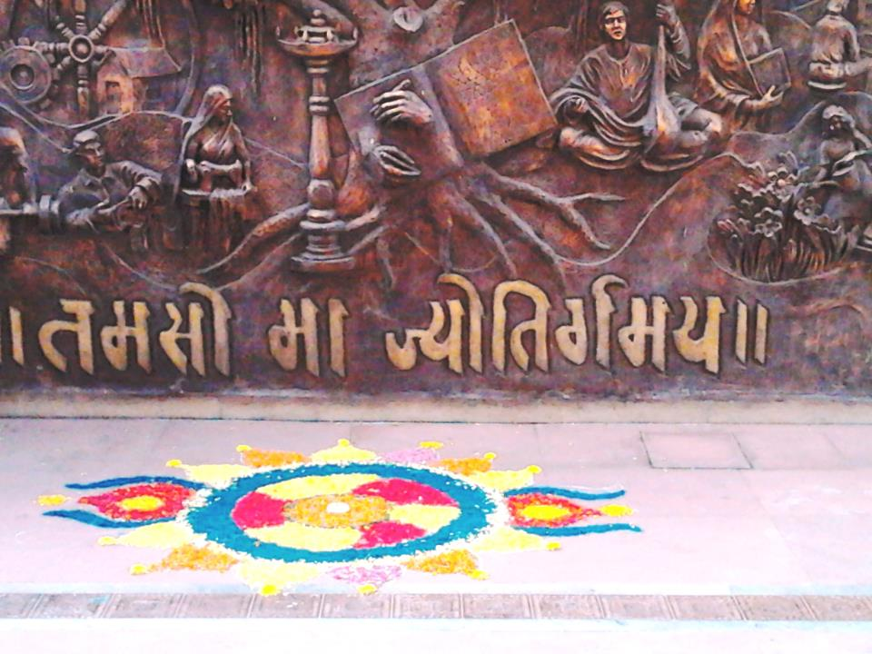
CHEMBUR COLONY YUVAK MANDAL’S
HASHU ADVANI COLLEGE OF SPECIAL EDUCATION

Slide 2
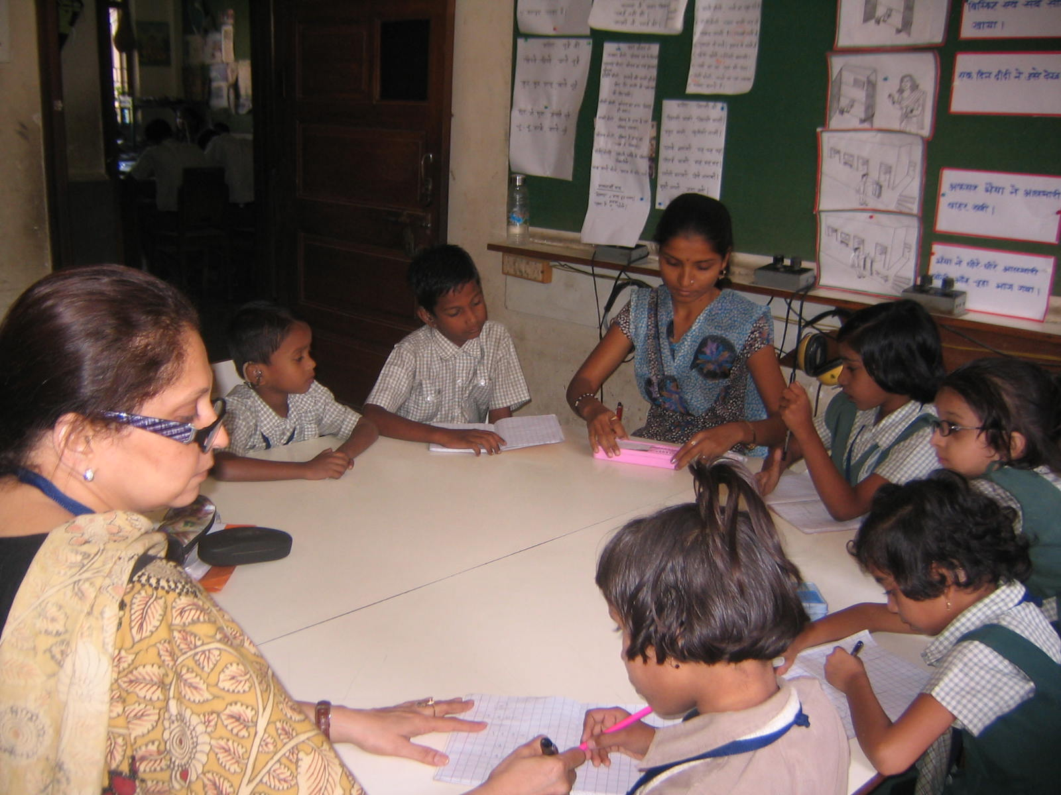
HACSE: we create resources…

Slide 3
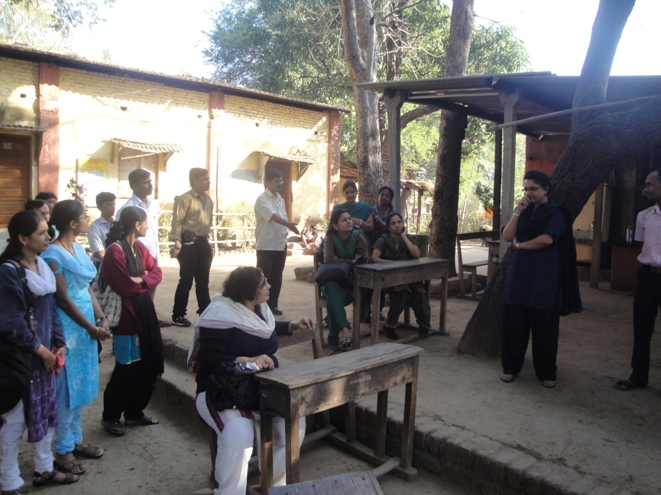
HACSE: we create interest …

Slide 4
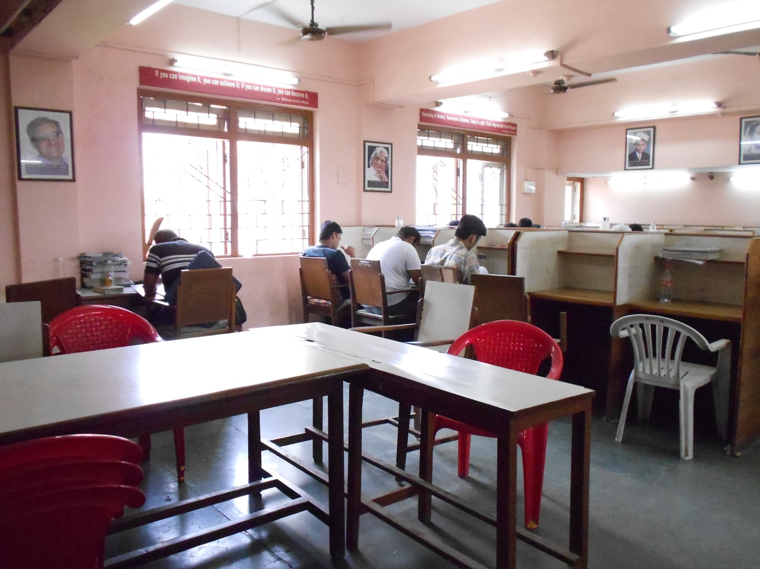
HACSE: we create spaces….

Slide 5
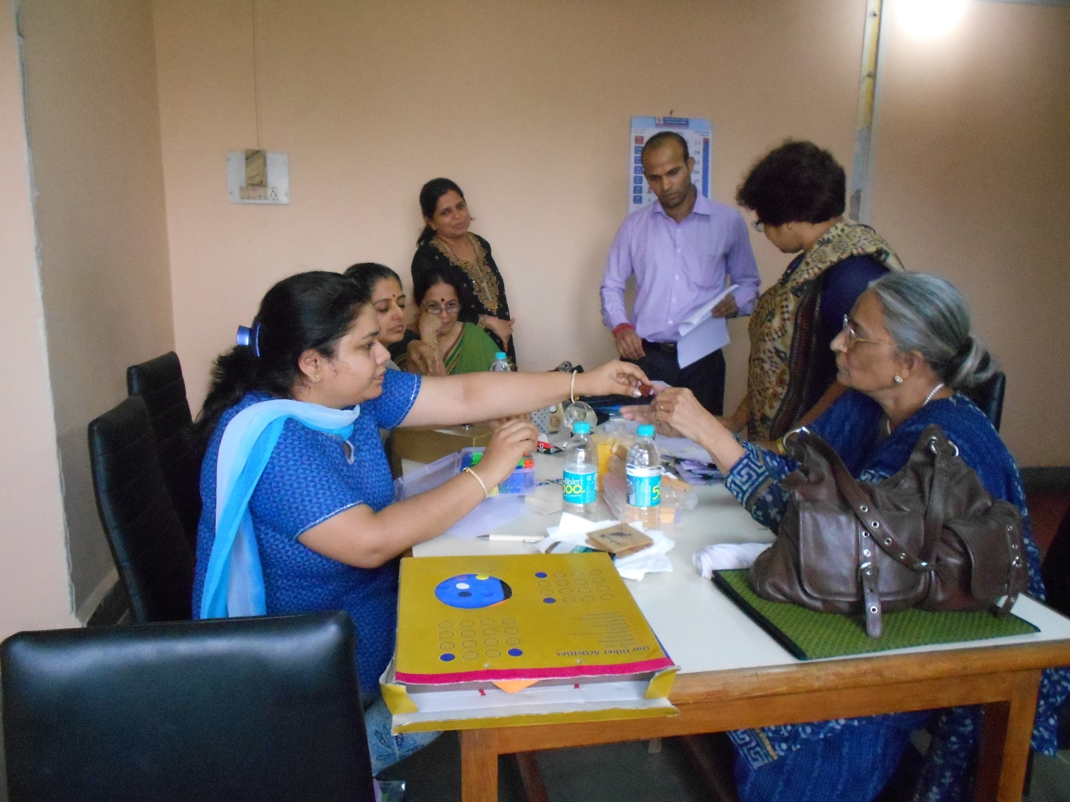
HACSE: we create impressions…

Slide 6
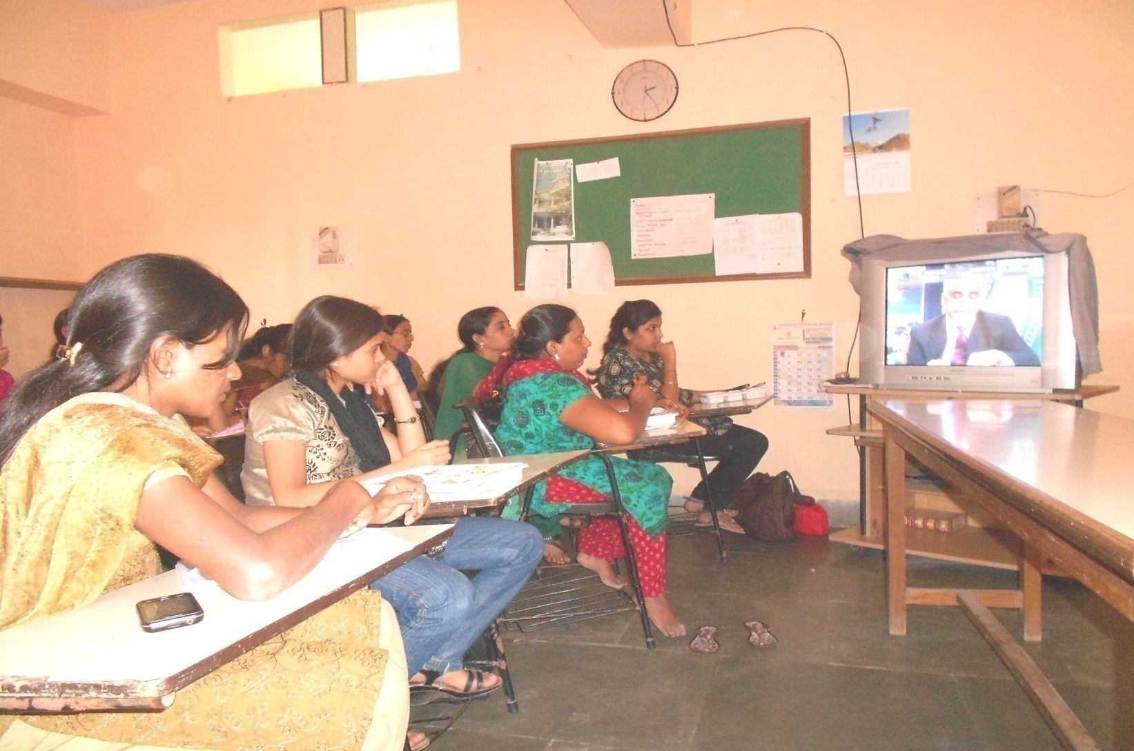
HACSE: We create environment….

Slide 7
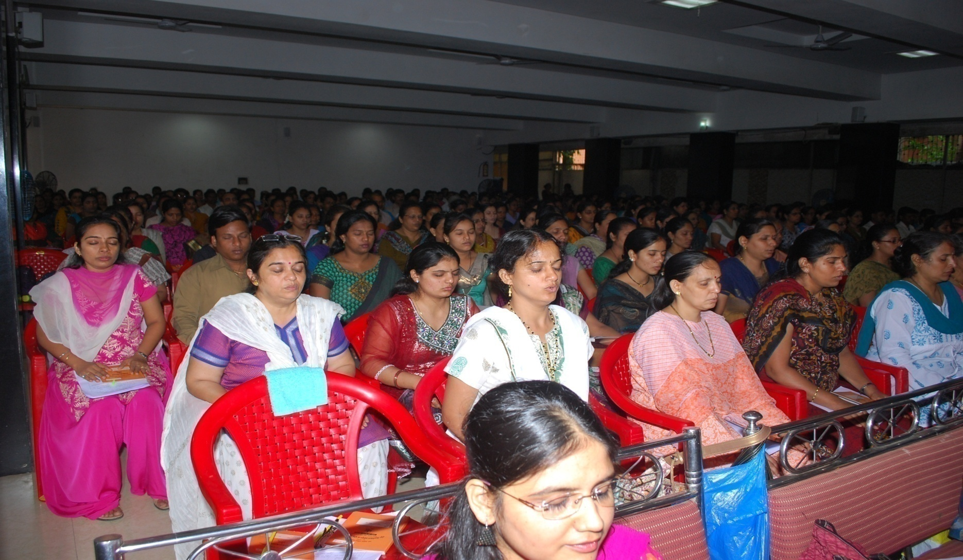
HACSE: We create thoughts….

Slide 8
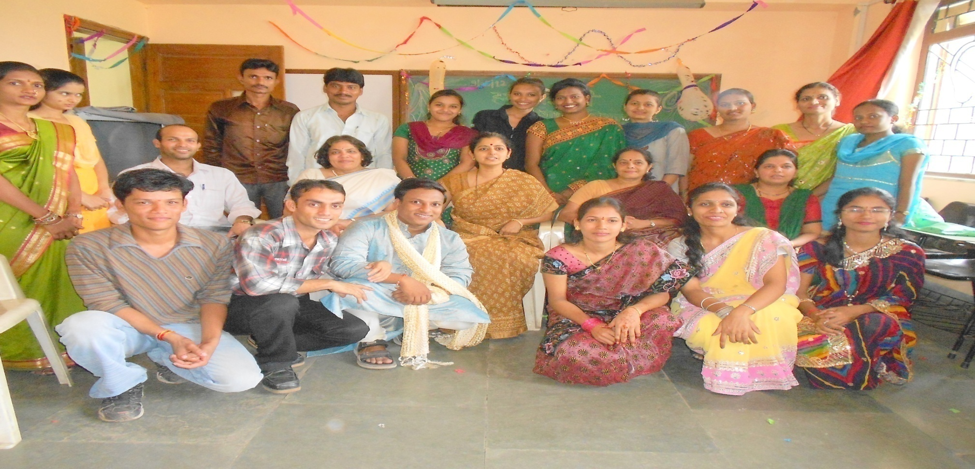
HACSE:www.hacse.org.in
YES, we also create teachers!

